Slide 1
SKIN DISEASES DUE TO PHYSICAL AGENTS

Slide 2
Ultraviolet(UV) light is part of solar radiation.
It consists of three types:
1-UV-A: 320-400 nm
2- UV-B: 290-320 nm causing sun burn
3- UV-C: 100-290nm …. Germicidal

Slide 3
Normal response of skin to UV exposure is tanning :
1- immediate: start after few minutes after exposure & last for few hours. It is due to UV-A which causes photo-oxidation of pre-existing melanin.
2- delayed : start after few hours after exposure & last for 2-3 wks. It is due to UV-B which causes production of new melanin by melanocytes

Slide 4
Melanin is important to protect the epidermis from sun damage especially the basal layer by forming umbrella like supranuclear capping

Slide 5
sunburn
Is first degree burn, characterized by erythema, swelling, sever itching & burning sensation, even blisters in sever cases, occur in white skin people. The onset is few hours after sun exposure & fade gradually within a week by desquamation
treatment: topical xylocaine cream
systemic or oral NSAIDS

Slide 6
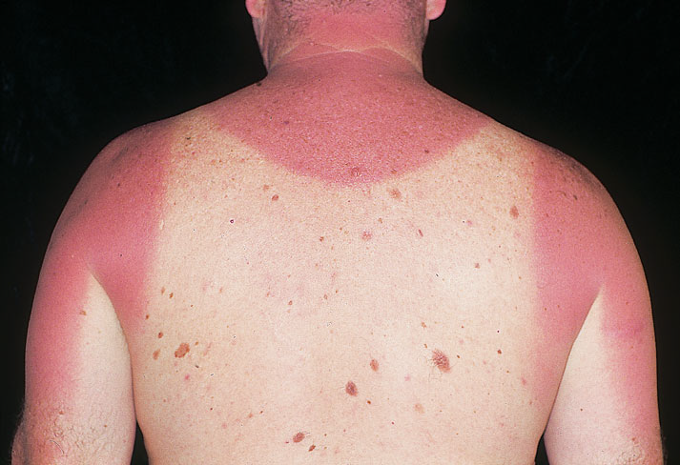

Slide 7
Photodermatosis
Classification:
1- metabolic: porphyria cutnea tarda, xeroderma pigmentosa, pellagra
2-drug-induced: topical & systemic
3-diseases aggravated by sunlight: SLE, herpes simplex, rosacea, erythema multiforme, seb. Dermatitis
4- idiopathic:

Slide 8
A- polymorphic light eruption:
Commonly seen in women between 30-40 yrs , caused by UV-A or UV-B light. The lesions started after few hours & last for few days, commonly seen in spring & early summer.
The rash consist of itchy papules or macules or plagues & occasionally small vesicles or urticarial lesions are seen on sun exposed sites

Slide 9
Treatment: avoid sun light, using sun screen
symptomatic treat. With oral anti histaminic topical steroid.
chloroquine or B – caroten(60mgx2for2wks)
azothioprine for refractory cases

Slide 10
B- others: rare
1- hydroa estivale(Hutchson summer prurigo)
2- Hyroa vacciniforme
3- Solar urticaria

Slide 11
Drug – induced photosensitivity
1-systemic drugs: such as brufen, phenothiazine, sulfa, nalidixic acid, frusamide, chlorpropamide, gresiofulvin.
C/F: after sun light exposure pt. develop diffuse erythema, itching & burning sensation on sun exposed skin
2- topical agents: include:
- Tar

Slide 12
- psoarlen:
found in oil of pergamot(perfume) pt. develop itching & erythema s.t blisters at the site of perfume application followed healing with post-inflammatory hyperpigmentation usually with bizzare shape at site of the neck ( Berloque dermatitis)

Slide 13
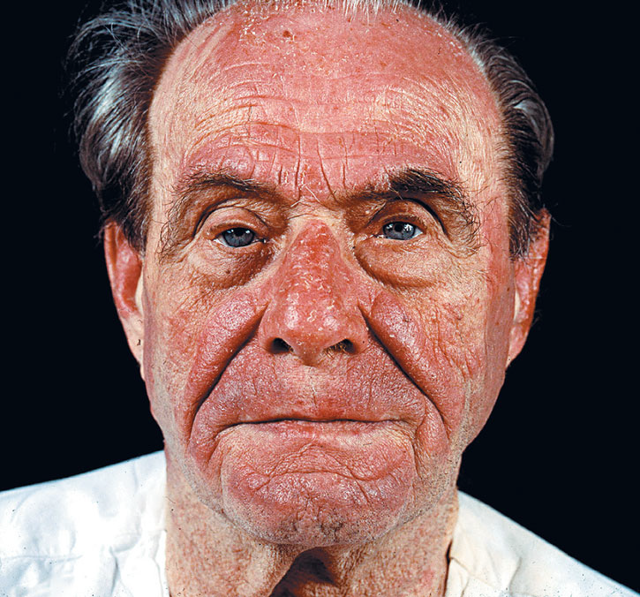

Slide 14
- plants: unribben citrus fruit containing psoralen compound in its shell. After contact with skin & after sun exposure pt. will develop itching or burning sensation & erythema at site of contact especially hands in women & perioral skin in children & usually healed with post inflammatory hyperpigmentation (phyto photo dermatitis).

Slide 15
Skin reaction to cold
1- chilblain (perniosis)
After cold exposure pt. develop itchy painful erythematous swellings on fingers & toes & s.t nose & ear. In sever cases may cause blisters & ulcerations. It is commonly see in young people especially blacks. It subside within 1-2 wks.

Slide 16
Treat.- cold protection by wearing thick gloves& stocks
- gradual rewarming
- topical corticosteroid
- vasodilator in sever cases:
nifedipine 200mg/ d

Slide 17
2- Raynaud s phenomenon:
After cold exposure the fingers first become white & then blue & then become red.
Causes:
A- Raynaud s disease
B- occupational: pneumatic drill, piano player
C- CTDs: scleroderma, SLE, dermatomyositis, Rheumatoid arthritis

Slide 18
D- neurological: cervical rib
E-occlusive arterial diseases: Buergers disease
F-toxins & drugs: ergot, B-blockers,cyclosporine
G- immunoglobulin disorders: cyrogloulinemia
H- cancer & cancer chemotherapy
Treatment:-treat the underlying cause
- protection from cold
- vasodilators: nifedipine 100mgx2/d
- sympathectomy in sever cases

Slide 19
- acrocyanosis:
persistant bluish discoloration of the hands & feet which may persist during winter time

Slide 20
Erythema ab igne:
A characteristic reticular telangiectatic and pigmented dermatosis, resulting from repeated or prolonged exposure to IR
radiation. It most commonly affects the legs of women.

